Slide 1
Research Design

Slide 2
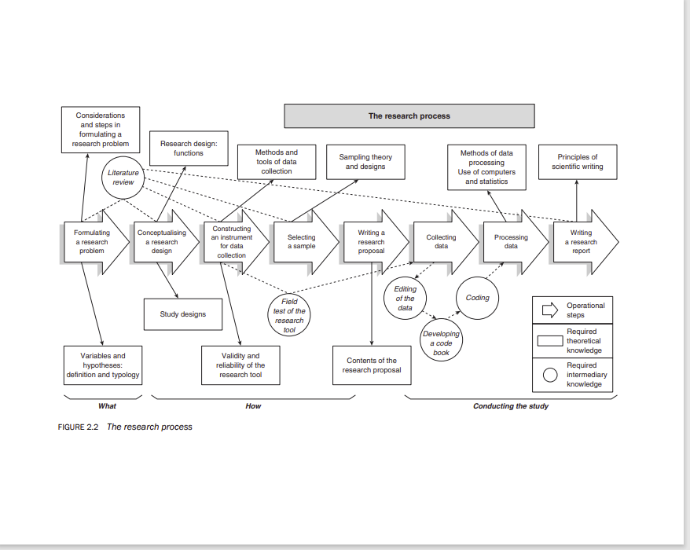
Research Process

Slide 3
The Eight Steps of Research Process
Step 1. Formulating a research problem
- decide what you find out about
Step 2. Conceptualising a research design
- the main function is to explain how you will find answers to you research questions
Step 3. Constructing an instrument for data collection
- the first practical step in carrying out a study
- decide how to collect data for the study
- construct a research instrument for data collection
Step 4. Selecting a sample
- sampling is done to minimize, within the limitation of cost, the gap between the values obtained from
the sample and those in the population.
- a sample is a small number of units selected in a manner that represent the study population.

Slide 4
The Eight Steps of Research Process
Step 5. Writing a research proposal
- tells the reader about the research problem and how you’re planning to investigate.
- writing the detailed operational plan for finding answers to your research problem
Step 6. Collecting data
- actual collection of data from which you will draw inferences and conclusion to your study.
Step 7. Processing and analysis of data
- depends on what type of research used – qualitative or quantitative or mixed method
Step 8. Writing a research report
- depends on what type of research used – qualitative or quantitative or mixed method

Slide 5
Sources of Research Topics/Ideas - the 4P’s
People
individuals
organizations
groups
communities
Problem
- issues situations, conditions,
concerns etc.
Program
- contents, structures, outcomes, attributes, satisfaction
Phenomenon
- phenomenon itself, cause and effect, relationships
Note: Can be a combination of at least 2 p’s
R. Kumar, 2011

Slide 6
Sources of Research Topics/Ideas - the 4P’s
The emotional and mental health of the head of the family
in the time of pandemic
problem and program
people
phenomenon

Slide 7
Research Problem – Ideas for new studies
Method
Rationale
Author’s results have significant
importance and can be verified with different people/subject, that is why it is replicated or repeated.
Replication
Extension
Extended because variable/s has been excluded; examine for theoretical significance, or better measurement or didn’t conduct the appropriate analysis, etc. Can extend by conducting a similar study which will lead to the improvement of the research literature.

Slide 8
Research Problem – Ideas for new studies
Method
Rationale
Testing the external validity (i.e., generalizability) of a study
Suggestions for important issue would work well in your intended research environment.
Improving a study’s internal validity (i.e., accuracy of claims about causation)
You might realize that the study did not control one or more important variables and the lack of control of these variables led to an ambiguous interpretation of the results.
Found conflicting results in the study that you have read that you want to conduct a new study to resolve the conflict. Conflicting results are due to different ways in which the studies were conducted, use of different measurement instruments, or use of different participant populations.
Reconciling conflicting results

Slide 9
Research Problem – Ideas for new studies
Method
Rationale
Especially in new areas of inquiry, one might use the grounded theory (generated and developed from the data gathered by the researcher) data to explain how and why some interesting phenomenon operates. One might also test additional implications of an existing theory.
Generating a new theory
Suggestions for future research
One of the easiest ways to get ideas from past research is to look for the author’s suggestions for future research. This is frequently valid and excellent sources of research ideas.
Theses and dissertations / studies done
A section devoted to future research that identifies subsequent studies the author believes need to be completed.

Slide 10
Reminders in Choosing Research Topics/Ideas
Make the topic small. Think small rather than big.
- limit the scope and scale of research: think narrow rather than broad
Keep the focus clear, limited, bounded and narrow.
Don’t be over ambitious.
Be realistic on what can be done in the time available, consider the current situation and whether, or how much this might compromise the viability and worth of the research.
Decide what can and cannot be done within the time and timescale available.
Decide why the research is important, topical, interesting, timely, significant, original relevant and positively challenging.

Slide 11
Reminders in Choosing Research Topics/Ideas
Choose a research that will be useful, and decide how and for whom it will be useful – significance of the study.
Choose a topic that is manageable and practicable.
Decide what the research will “deliver”?
What will the research do?
Choose a topic for which there is a literature.
Decide what can and cannot be done within the time and timescales available.
Consider whether you have the right personality, characteristics, experience and interpersonal behavior to conduct the proposed piece of research.

Slide 12
Reminders in Choosing Research Topics/Ideas
Choose a topic for which you know you will able to receive expert, informed supervision.
Be clear on why you – personally, professionally, career relatedly – want to do the research and what you personally want out of it, and wheather the research will enable you to achieve this.
Choose a topic that will sustain your interest over the duration of the research.
Consider the necessary complexity (where it exists) of the research phenomenon, scope and conduct of the research and the difficulty of the research issues, foci and conduct.
Consider how future research will be able to build on your research, i.e that the research opens up possibilities rather closes them down.

Slide 13
Variable
- a characteristic or attribute of an individual or an organization that can be measured or observed and that varies among the people or organization being studied.
Types of variable:
• Independent variables - those that (probably) cause, influence, or affect outcomes. Also
called treatment, manipulated, antecedent, or predictor variables.
• Dependent variables - those that depend on the independent variables. They are the
outcomes or results of the influence of the independent variables. Also known as criterion, outcome, effect, and response variables.
• Intervening or mediating variables - stand between the independent and dependent variables.
They mediate the effects of the independent variable on the dependent variable.
Example: IV DV
smoking causes lung cancer
IV I DV
smoking damaged lung cancer
lung cells

Slide 14
Variable
• Extraneous variable - any other variable that could affect the dependent variable, but is not explicitly included in the experiment. (https://stattrek.com/statistics/dictionary.aspx?definition=extraneous-variable)
- variable that is not intentionally being studied in the test. (https://www.statisticshowto.com/extraneous-variable)
Example:
A hungry student taking a test .

Slide 15
Research Hypothesis
prediction the researcher makes about the expected outcomes of relationships
among variables
- often used in experiments in which investigators compare groups.
- must be capable of being confirmed or not confirmed
Example:
Is there a significant difference between the scores of students taught by using the lecture approach and the scores of students taught by using the cooperative learning approach?

Slide 16
Research Design
- plan or strategy that is drawn up for organizing the research and making it practicable, so that research questions can be answered based on evidence and warrants. ( Cohen,et al, 2018)
- the overall scheme or program of the research
Note: It is the purpose of the research that determines its design.
example: You want to know the general comments of the public on the government’s response to the pandemic a year after the lockdown.
A survey design might be suitable.

Slide 17
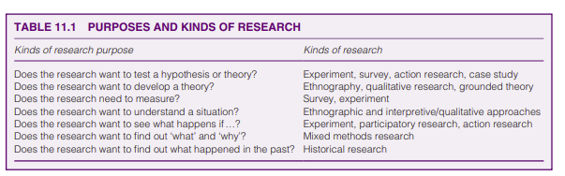
Research Design
( Cohen,et al, 2018)

Slide 18


Research design
Considerations and steps in formulating
research problem
Research design:
functions
Literature
review
Formulating a research problem
Conceptualising a research resign
Study designs
Variables and hypotheses: definition and typology

Slide 19
Other Research Terms
Reliability – in research means consistency: do we get the same result if measured repeatedly?
Validity is about whether our measurement really measures our concept (or something else)? Is it meaningful as a measurement tool for this concept?
internal validity – answers the questions: Was the research sound? Was the research done right?
external validity –results can be generalized to different groups of people, situations and measures
Generalizability– simply a measure of how useful the results of a study are for a broader group of people or situations. (https://www.hydroassoc.org/research-101)

Slide 20
Literature Review
process of searching the existing literature relating to your research problem to develop theoretical and conceptual frameworks for your study
Specifically, a review of the literature:
• will tell you whether the problem you have identified has already been researched. If it has, you should either revise the problem in light of the results of other studies to build on the previous literature or look for another problem, unless you think there is a need to replicate the study.
• will assist you in forming your research questions
• might give you ideas as to how to proceed with and design your study so that you can obtain an answer to your research question(s).

Slide 21
Literature Review
• can point out methodological problems specific to the research question(s) you are studying. Are special groups or special pieces of equipment needed to conduct the research? If so, the literature can give clues as to where to find the equipment or how to identify the particular groups of participants needed.
• can identify appropriate data-collection instruments so that you will not need to construct a new instrument. Familiarity with the literature will also help after you have collected your data and analyzed your results.

Slide 22
Sources of Information in a Literature Review
books
articles in journals
empirical and non-empirical research
reports
policy documents
public and private records
research papers and reports
theses and dissertations
manuscripts

Slide 23
Sources of Information in a Literature Review
databases
conference papers
primary sources
online databases
electronic journals or media
secondary sources – second hand, non-original materials like encyclopedias, newspaper articles, research syntheses, reports etc.
tertiary sources – collections or compilations of primary and secondary sources like almanacs, bibliographies, handbooks, indexes, abstract etc.

Slide 24
Types of Research Designs
Quantitative
Qualitative
expressed in words.
used to understand concepts, thoughts or experiences.
enables you to gather in-depth insights on topics that are not well understood.
Examples:
interviews with open-ended questions, observations described in words, and literature reviews that explore concepts and theories.
expressed in numbers and graphs.
used to test or confirm theories and assumptions.
can be used to establish generalizable
facts about a topic.
Examples: experiments, observations recorded as numbers, and surveys with closed-ended questions.
https://www.scribbr.com/methodology/qualitative-quantitative-research/

Slide 25
Types of Research Designs
Mixed Methods
involves collecting both quantitative and qualitative data, integrating the two forms of data, and using distinct designs that may involve philosophical assumptions and theoretical frameworks.
- the core assumption of this form of inquiry is that the combination of qualitative and quantitative approaches provides a more complete understanding of a research problem than either approach alone.
Example:
DeLuca, S., & Rosenblatt, P. (2010). Does moving to better neighborhoods lead to better
schooling opportunities? Parental school choice in an experimental housing voucher
program. The Teachers College Record, 112(5), 7-8.
J. Creswell, 2015

Slide 26
Types of Research Designs Qualitative
1. Interview
Any person-to-person interaction, either face to face or otherwise, between two or more individuals with a specific purpose in mind.
Involves asking questions of respondents and recording their answers.
Can be structured or unstructured
example: job interview of applicants or reporter’s interview with respondents
2. Observation
- a purposeful, systematic and selective way of watching and listening to an interaction or phenomenon as it takes place.
example: a mother watching her kindergarten son on his first day of school
3. Focus Group
attitudes, opinions or perceptions towards an issue, product, service or programme are explored through a free and open discussion between members of a group and the researcher.
like collectively interviewing a group of respondents.

Slide 27
Types of Research Designs Qualitative
example: small group discussion of doctors specializing in infectious disease
4. Ethnography - study and describe the functioning of cultures
through a study of social interactions and expressions between people and groups.
example: center for the elders
5. Case study
the ‘case’ becomes the basis of a thorough, holistic and in-depth exploration of the
aspect(s) that one wants to find out about.
the total study population is treated as one entity and studied intensively.
example: An investigation of the occurrence of hate crimes among
Asians in the USA.

Slide 28
Types of Research Designs Quantitative
Experimental research
seeks to determine if a specific treatment influences an outcome in a study.
tests the impact of a treatment (or an intervention)on an outcome, controlling for all other factors that might influence that outcome.
“If I do this to one group but not the others (cause) does it change the outcome (effect)? (www.Omegastatistics.com)
example: The side effects of the covid-19 vaccines among different races
in the world.
2. Non- Experimental
2.1 Survey
research method based on questionnaires or interviews.
provides a quantitative or numeric description of trends, attitudes, or opinions of a population by studying a sample of that population.

Slide 29
Types of Research Designs Quantitative
2.2 Descriptive - describes the subject with words or numbers or both
example: health and wellness of call center agents
2.3 Correlational – measures the relationship or association between variables
of the study
example: age and job satisfaction
2.4 Causal Comparative – focus is on the effect of an independent variable on a dependent variable by comparing two or more groups of individuals.
example: Behaviors of the children and the elderly towards
lockdown in this time of pandemic.

Slide 30
Types of Data Collection Instruments of the Research Designs
Qualitative
Quantitative
in-depth interviews
focus groups
observations
on-line forums
web chats
surveys
structured observation methods
questionnaires
online
reports
https://www.scribbr.com/methodology/qualitative-quantitative-research/

Slide 31
Types of Data - Research Designs
Quantitative
Qualitative
descriptive data expressed in words
responses of open-ended questions
- data usually are focused on individual experiences and beliefs
numerical data
results of close ended questions
data on describing the characteristics of the population
https://www.scribbr.com/methodology/qualitative-quantitative-research/

Slide 32
Data Collection - Research Designs
Quantitative
Qualitative
descriptive data expressed in words
responses of open-ended questions
data usually are focused on individual experiences and beliefs
- field notes or memos
numerical data
results of close ended questions
data on describing the characteristics of the population
https://www.scribbr.com/methodology/qualitative-quantitative-research/

Slide 33
Analysis of Data - Research Designs
Quantitative
Qualitative
Thematic analysis - themes emerged from the data
Comparative analysis -data from different people is compared and contrasted and the process continues until the researcher is
satisfied that no new issues are arising.
Content Analysis- researcher systematically works through each transcript assigning codes, which may be numbers or words, to specific characteristics within the text.
Basic statistical tests such as:
frequency counts
cross tabulations
correlation
T-test
Chi-square
ANOVA
Using statistical software such as: Excel, SPSS,
SAS etc.

Slide 34
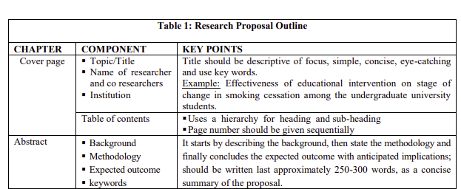
Research Proposal Outline

Slide 35
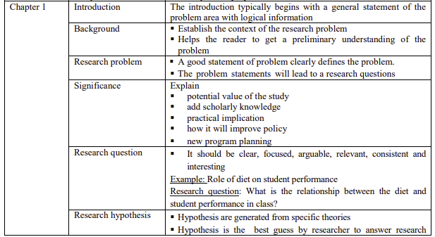

Slide 36
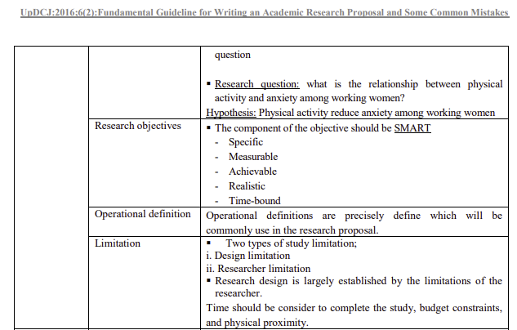

Slide 37
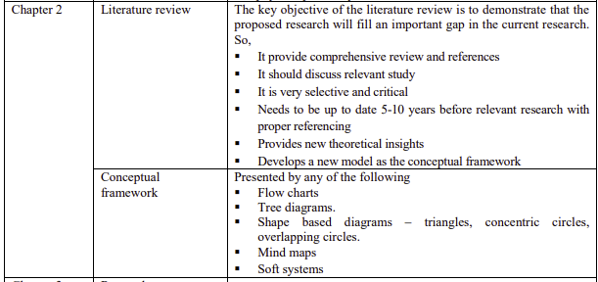

Slide 38
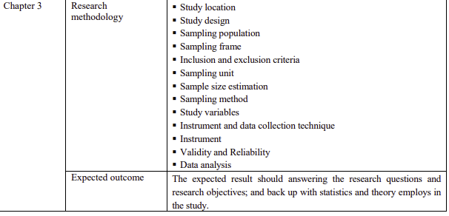

Slide 39
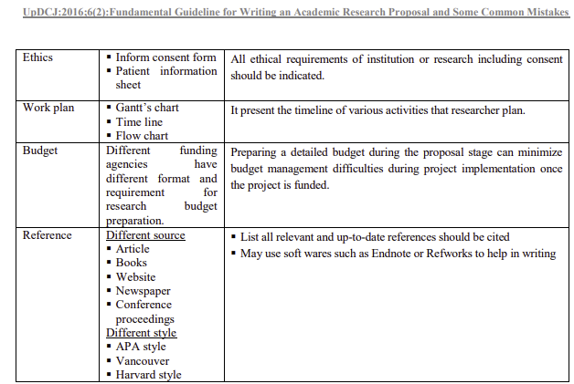
Samia A., and Saiful. A, 2016.

Slide 40
References
Bacon-Shone, John. (2015). Introduction to Quantitative Research Methods. Retrieved from
http://creativecommons.org/licenses/by-nc-sa/4.0/
Bordens, Kenneth and Bruce Abbott. Research Design and Methods: A Process Approach 10th
edition. New York: McGraw Hill Education, 2018.
Cohen, L, Manion, L. and Morrison, K. Research Methods in Education 8th ed. New York: Routledge, 2018.
Creswell, John. Research Design. New York: SAGE Publications, 2015.
Dawson, Catherine. Introduction to Research Methods. A Practical Guide for undertaking a research project. United Kingdom: How to Content, 2009.
Heffner, Christopher L. Chapter 1.11 Replication. Retrieved from Johnson, R. Burke; Christensen, Larry B. (2017). Educational Research: Quantitative, Qualitative and Mixed Approaches. SAGE Publications. Kindle Edition.
Exemplary Mixed Methods Research Studies. Compiled by the Mixed Methods Working Group
Funding provided by the Spencer Foundation*
Kumar, Ranjit. Research Methodology: Step-by-Step Guide for Beginners. Singapore: Sage Publications Asia Pacific Ltd, 2011.

Slide 41
Marin, William and Bridgmon, Krista. Quantitative and Statistical Research
Method: From Hypothesis to Results. New York: Jossey-Bass, 2012.
Quantitative Research: Reliability and Validity. Retrieved from www.pdx.edu/studentaffairs/sites/
Rovai, Alfred P. (2014). Social Science Research Design and Statistics: A Practitioner's Guide
to Research Methods and IBM SPSS Analysis .Chesapeake, Virginia. Watertree Press .
Kindle Edition.
Samia A., and Saiful. A. Fundamental Guideline for Writing an Academic Research Proposal and Some Common Mistakes Editorial. Updat Dent. Coll .j 2016;6(2):01-05.
Writing Guides. Retrieved from writing.colostate.edu/guides
http:/allpsych.com/researchmethods/replication
https://b-ok.asia/book/3378498/611896
www.Omegastatistics.com
https://www.scribbr.com/research-process/research-design/

Slide 42
https://www.scribbr.com/research-process/research-design/
https://stattrek.com/statistics/dictionary.aspx?definition=extraneous-variable
https://www.statisticshowto.com/extraneous-variable
https://www.scribbr.com/methodology/qualitative-quantitative-research/

Slide 43
Thank You!

